Slide 1

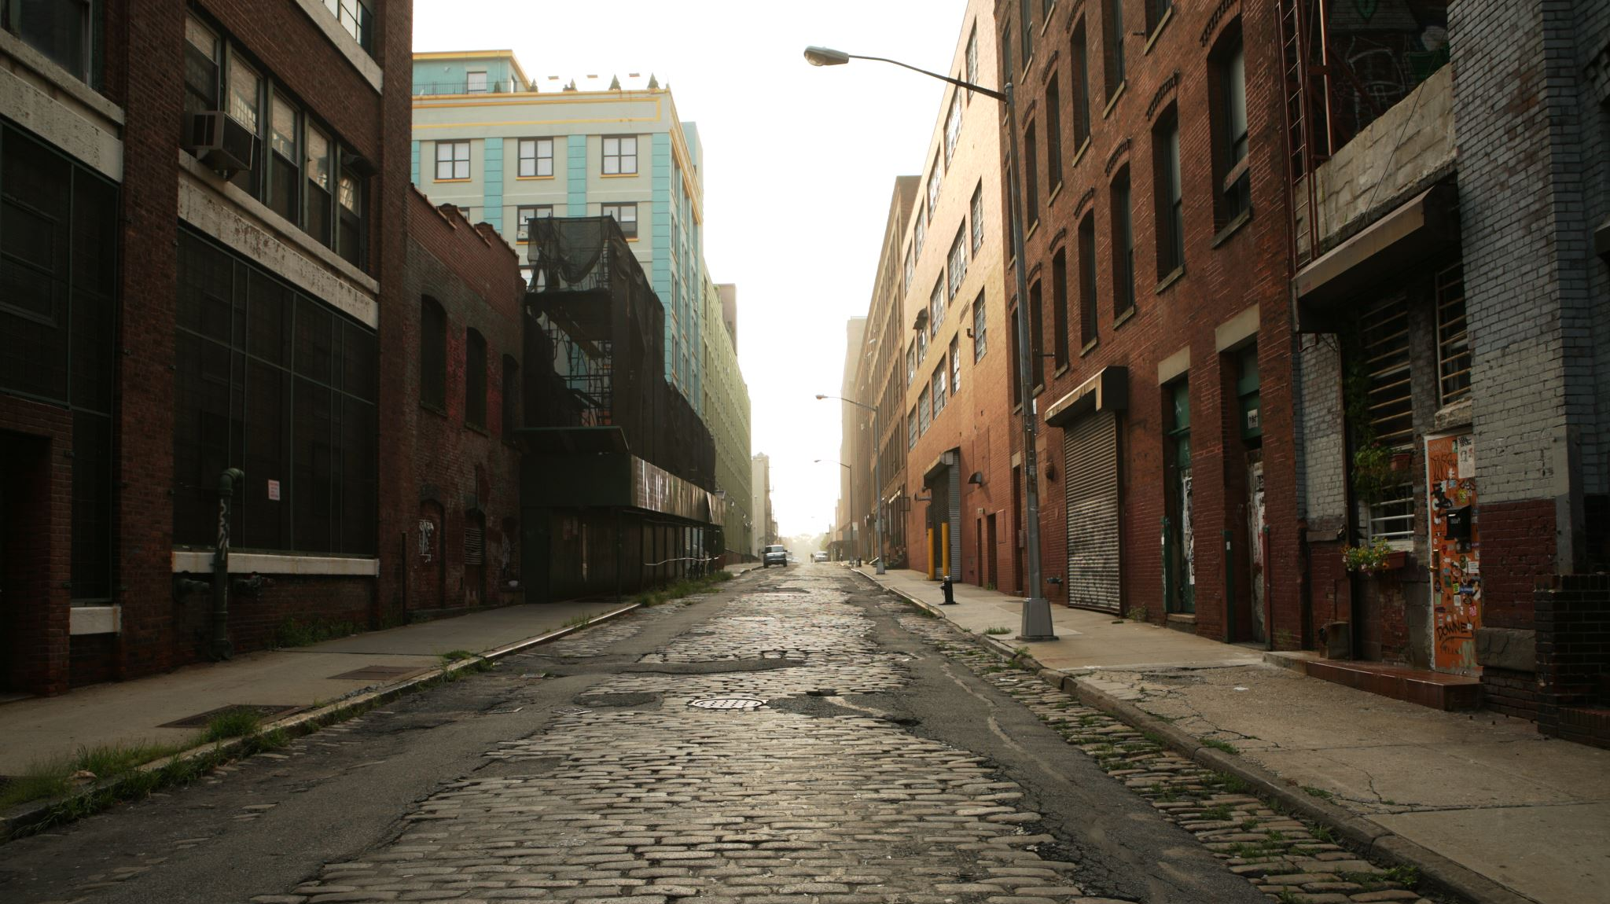
Making Nashville’s Streets Safer
Where are Crashes Happening and What May be Causing Them?

Slide 2
Inspiration / Context
Vision Zero Initiative
East Nashville’s Walkability
Outdated Urban Planning Practices
Study Corridor:
Typically Five Lanes
Two travel lanes each direction
One center two-way left turn (TWLT) lane
Total roadway width in background photo: ~60 ft
Lots of curb cuts / driveways

Slide 3

Data Collection
Source: Nashville Open Data Portal
Included in Analysis:
Crash Reporting
311 Requests
Active Construction
Building Permits
Right-of-Way Occupancy Permits
Short Term Rental Properties
Pedestrian Signal Inventory

Slide 4
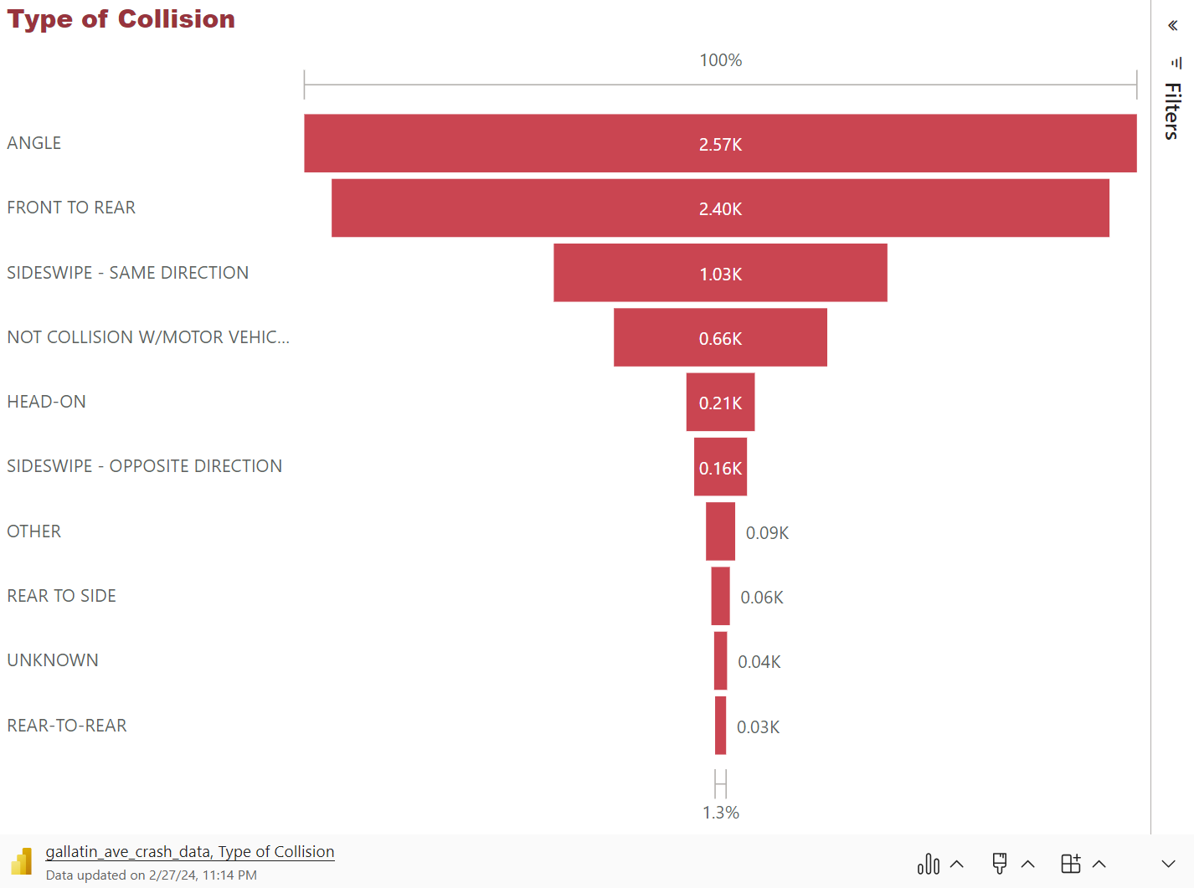
Crash Statistics
Text…

Slide 5
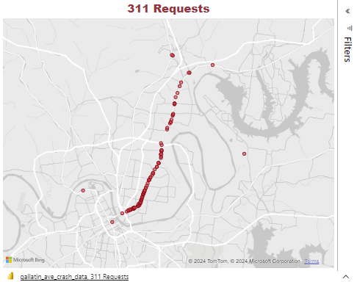
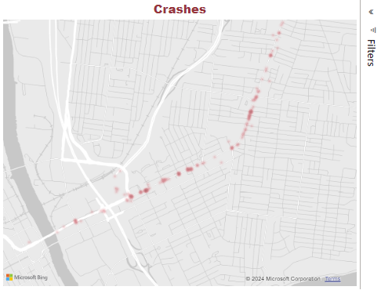
Crashes vs 311 Requests

Slide 6
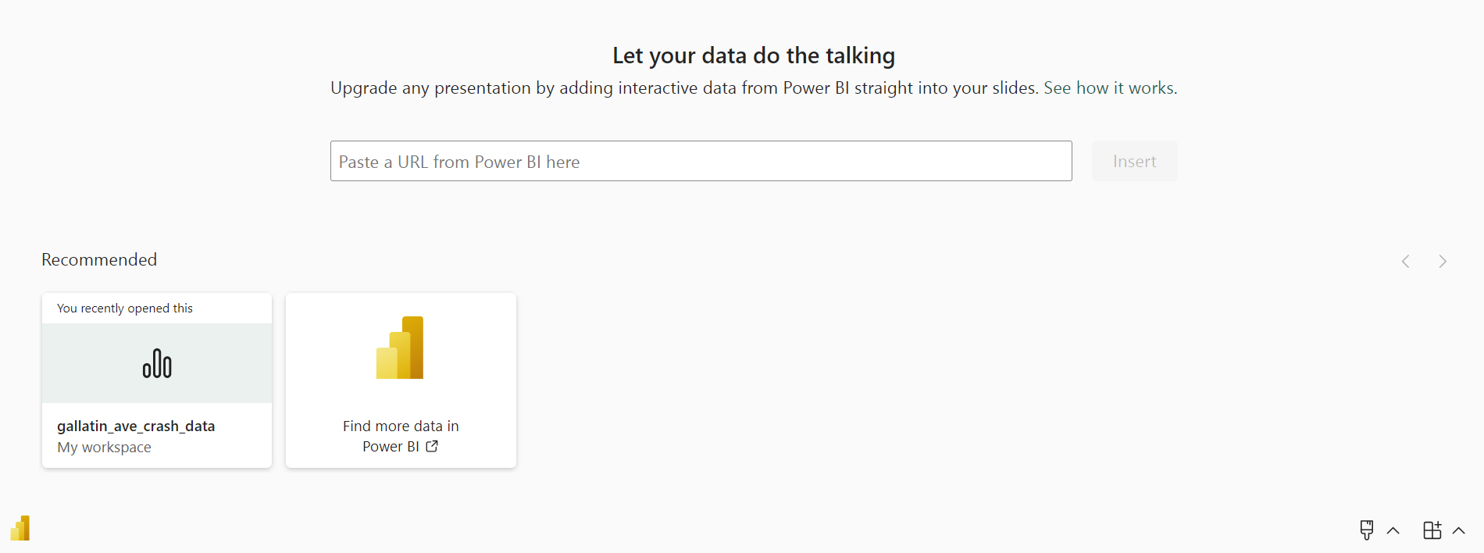
Crashes vs 311 Requests

